Slide 1

Multi-Model Approach for Genetic Mutation Prioritization in Cancer Detection
By group D10​
Vada Gouri Hansika Reddy[CB.SC.U4AIE23304]​
Malavika S Prasad[CB.SC.U4AIE23315]​
Katikala Deedepya[CB.SC.U4AIE23349]​
Geshna B[CB.SC.U4AIE23360]​

Slide 2
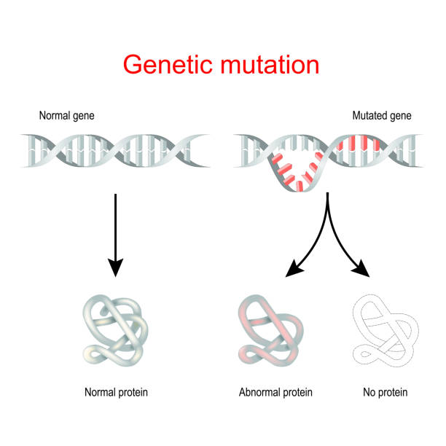
INTRODUCTION
Genetic Mutations Overview:
• Changes in DNA sequence forming a gene.
• Can range from single base pair alteration to larger chromosome segments.
• Can occur naturally or due to external factors.
• Crucial in evolution, diversity, and disease.
Types of Genetic Mutations:
Point Mutations
Insertion or Deletion (Indels)
Copy Number Variations (CNVs)
Chromosomal Mutations
Repeat Expansions
Causes of Genetic Mutations:
Spontaneous Mutations
Induced Mutations
Biological Agents

Slide 3
Project Overview
What the Project Entails: Our project focuses on leveraging Artificial Intelligence (AI) to analyze genetic mutation data in clinical texts and classify mutations into 9 categories. This process relies on both feature extraction and machine learning methods to interpret and categorize mutation details.
Purpose and Significance: Detecting and classifying genetic mutations accurately is crucial for cancer diagnosis and treatment planning. Automating this classification helps streamline the diagnostic process and enhance reliability.
Methods Employed: Our approach combines multiple feature extraction techniques—CountVectorizer, TF-IDF, Word2Vec, and Doc2Vec—with machine learning models, including Random Forest, Logistic Regression, XGBoost, and LightGBM.
Project Objective: To develop a robust model achieving at least 90% classification accuracy, demonstrating that machine learning can effectively interpret complex clinical text data for cancer mutation classification.

Slide 4
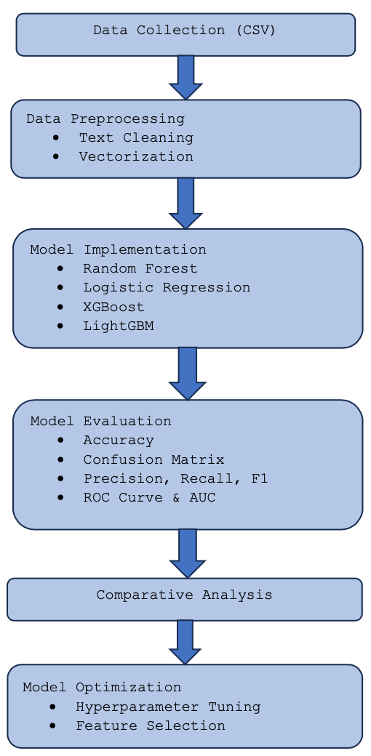
Summary of Methodology

Slide 5
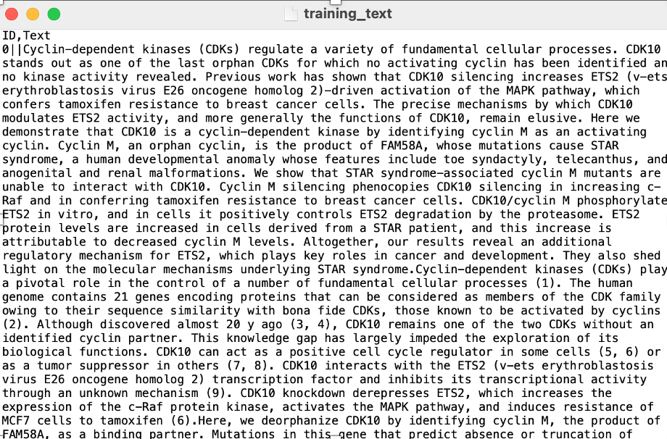
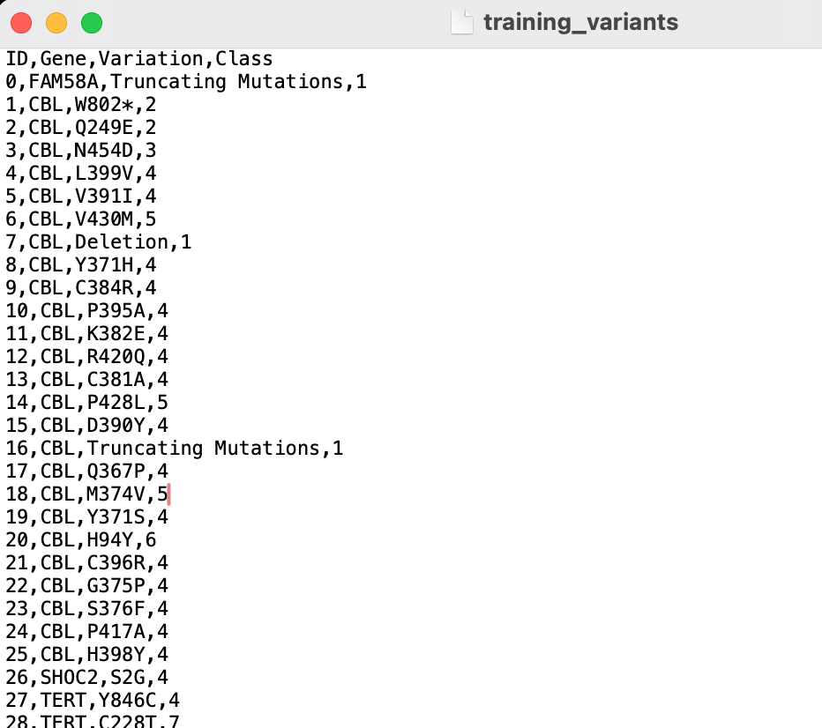
Dataset Overview
Name: msk-redefining-cancer-treatment (from Memorial Sloan Kettering Cancer Center)
Source: Kaggle
Type of Data:
Structured Data: Genomic mutation records.
Unstructured Data: Clinical notes and reports.
Unstructured text data
Structured Genomic data

Slide 6
01
EDA(Exploratory Data Analysis)

Slide 7
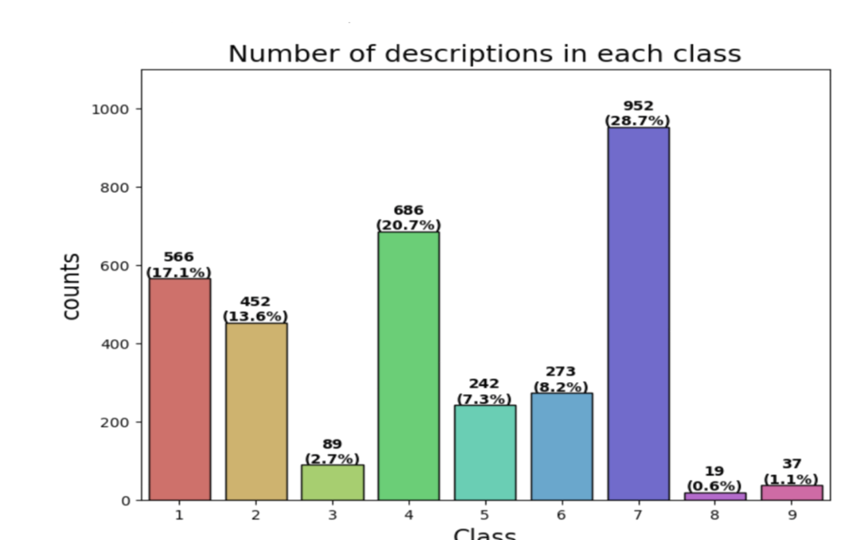
EDA
Class Distribution Analysis:
Objective: To understand the spread of data across the nine mutation classes.
Findings: Visual representations (e.g., bar chart) of each class reveal potential class imbalances, which could impact model performance.
Impact: Identifying these imbalances helps us determine if techniques like sampling or class weighting are necessary for effective classification.

Slide 8
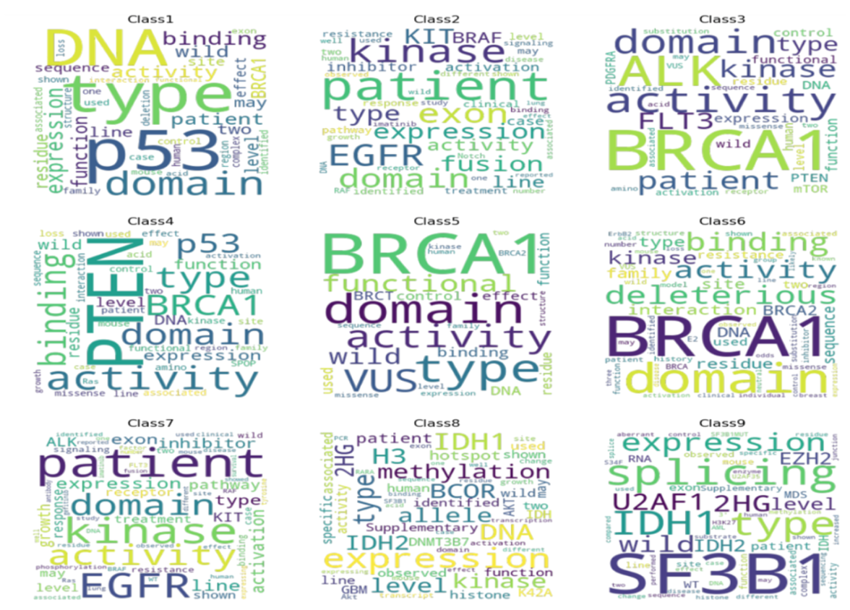
Textual Analysis and Insights
Text Analysis Objectives:
Text Frequency: Analyzed word frequency within each class to observe common terms and patterns, helping us understand distinctive linguistic characteristics.
Word Clouds and Frequency Charts: Visualized frequently occurring words in each mutation class to assess unique and overlapping language.
Insights for Preprocessing:
Common Terms Across Classes: Identified frequently used words, which informed our preprocessing decisions, such as stopword removal to reduce noise.
Unique Patterns for Specific Classes: Detected unique terms indicative of specific mutations, helping to tailor preprocessing steps to preserve meaningful context.

Slide 9
02
Feature Extraction Techniques

Slide 10
CountVectorizer
Overview of CountVectorizer: The CountVectorizer method converts clinical text into a matrix format where each word's occurrence is represented as a frequency count. This approach provides a straightforward, interpretable representation.
Process of Implementation:
Tokenization: Each clinical description is tokenized into individual words.
Vocabulary Creation: Builds a vocabulary of all unique tokens in the dataset.
Count Matrix Generation:Creates a sparse matrix where each row represents a document, and each column corresponds to a token from the vocabulary and each cell contains the count of the corresponding token in the document.
Rationale for Use: CountVectorizer is effective for scenarios where raw word occurrence is critical, providing a foundational text representation for machine learning models.
Challenges and Limitations: Although simple, this method does not account for word importance or context, leading to limitations in cases where meaning needs to be derived from word relationships.

Slide 11
TF-IDF Vectorizer
Introduction to TF-IDF: Term Frequency-Inverse Document Frequency (TF-IDF) assigns weights to words based on their importance in the document, thus prioritizing terms that are informative and appear uniquely within a document.
Process Explanation:
Term Frequency (TF): The frequency of each term within a document.
Inverse Document Frequency (IDF): A measure to downscale common terms that appear across multiple documents.
TF-IDF weights: Multiply TF and IDF values for each term.
Advantages: TF-IDF reduces the influence of frequent, less informative words and highlights unique words that may be critical for classification.
Applications in Our Model: By emphasizing unique terms, TF-IDF enhances the model's ability to differentiate between mutation classes based on nuanced language features.

Slide 12
Word2Vec
Understanding Word2Vec: Word2Vec is a neural network-based approach that converts words into numerical vectors while capturing their semantic meanings and relationships.
Implementation Steps:
Contextual Embedding: Words are represented based on the context they appear in, with neighbouring words influencing the vector.
Vector Representation: Each word is mapped to a vector, which encodes semantic similarity and meaning.
Two main approaches: CBOW and Skip Gram
Benefits for the Project: Word2Vec enables our model to understand relationships and context in clinical text, improving its ability to detect relevant mutations.
Limitations: This method can require substantial computational resources and may introduce complexities in interpretation.

Slide 13
Doc2Vec
Overview of Doc2Vec: Extending the Word2Vec approach, Doc2Vec creates embeddings for entire documents, capturing broader context across full clinical descriptions.
Methodology:
Paragraph Vectoring: Each clinical description is represented as a single vector that encapsulates the entire document’s meaning.
Contextual Embedding: Embeddings are influenced by the context of words and sentences within each document.
Advantages in Our Analysis: By capturing document-level features, Doc2Vec enables our model to consider broader contextual patterns, which is valuable for differentiating mutation classes based on detailed descriptions.
Challenges: Doc2Vec can be complex to implement and may be computationally intensive, especially on larger datasets.

Slide 14
Model Implementation
03

Slide 15
Logistic Regression
About Logistic Regression:
Purpose: Logistic Regression is used for binary classification problems, predicting probabilities and class labels based on input features.
Working Mechanism: It uses a logistic function to model the probability that a given input belongs to a particular class.
Why Logistic Regression: Known for simplicity and interpretability, it works effectively on linearly separable data, making it suitable as a baseline model in our classification task.
Project Relevance:
Application: We implemented Logistic Regression as one of our initial models to observe baseline performance, helping us benchmark improvements with more complex models.
Interpretability: By examining the coefficient values, we were able to identify which terms had a stronger influence on specific mutation classes.

Slide 16
Implementation Process:
Preprocessing Applied: Applied Logistic Regression to each vectorized data representation (TF-IDF, CountVectorizer, Word2Vec, Doc2Vec).
Hyperparameter Tuning: Used GridSearchCV to tune parameters such as C (regularization strength) to optimize model performance.
Key Findings and Observations:
Performance Results: Logistic Regression provided a solid baseline, with moderate accuracy across preprocessing techniques.
Insights: Analyzed the differences in performance when using various vectorizers, giving us insights into the suitability of each vectorizer for this model.
Challenges: Limitations in handling non-linear relationships were observed, paving the way for more complex models.

Slide 17
Random Forest
About Random Forest:
Purpose: Random Forest is an ensemble method that combines multiple decision trees, offering high accuracy and the ability to handle non-linear data.
Working Mechanism: Each tree is built on random samples of the data, with predictions aggregated to improve generalization and reduce overfitting.
Why Random Forest: Effective for datasets with complex patterns and interactions, making it suitable for genetic mutation classification.
Project Relevance:
Application: Implemented Random Forest to handle complex relationships within clinical data, as its ensemble approach improves predictive accuracy over single models.
Feature Importance Analysis: Analyzed feature importances, helping us identify terms or patterns most relevant to each mutation class.

Slide 18
Implementation Process:
Preprocessing Applied: Used on all vectorized data representations to explore how different feature extraction techniques impact Random Forest performance.
Hyperparameter Tuning: Optimized parameters like n_estimators (number of trees) and max_depth using GridSearchCV to achieve balanced performance.
Key Findings and Observations:
Performance Results: Demonstrated high accuracy, particularly on TF-IDF and Word2Vec, reflecting the model’s ability to capture complex patterns.
Insights: Observed that Random Forest performed better with certain vectorizers, highlighting its adaptability to feature extraction techniques.
Challenges: High computational cost and model complexity made interpretability more challenging compared to simpler models.

Slide 19
XGBoost
Overview:
XGBoost (Extreme Gradient Boosting) is a powerful machine learning algorithm for both classification and regression tasks.
It is based on boosting, an ensemble technique where multiple weak models (decision trees) are combined to form a strong predictive model.
Key Features:
Ensemble Learning: Combines predictions from multiple decision trees to improve performance.
Gradient Boosting: Each tree corrects the errors made by the previous one.
Regularization: Prevents overfitting through parameters like lambda and alpha.
Parallelization: Efficient training on large datasets by utilizing multiple cores.
Application: Implemented XGBoost for its high accuracy and efficiency which makes it valuable for datasets with larger feature sets, as generated by techniques like TF-IDF and Word2Vec.

Slide 20
Project Relevance:
Used for classification of genetic mutations into nine classes based on clinical text data.
Multi-Class Classification: XGBoost handles complex multi-class tasks with high accuracy.
Implementation Process:
Preprocessing: Text data is vectorized using methods like TF-IDF, Word2Vec, etc.
Hyperparameter Tuning: Optimized using GridSearchCV to find best parameters like n_estimators, learning_rate, and max_depth.
Key Findings and Observations:
Performance Results: Consistently high accuracy across most vectorizers, making XGBoost one of our top-performing models.
Insights: XGBoost particularly excelled with TF-IDF and Doc2Vec, likely due to its ability to capture non-linear patterns.
Challenges: Increased complexity and longer training time, though mitigated by XGBoost’s efficient design.

Slide 21
LightGBM
What is LightGBM?
•A fast and efficient machine learning algorithm for largedatasets.
•Based on gradient boosting: builds trees to reduce errors sequentially.
Why LightGBM?
•Speed: Uses a histogram-based approach for faster training.
•Accuracy: Grows trees leaf-wise, focusing on high-error areas.
•Scalable: Handles large feature sets like TF-IDF, Word2Vec efficiently.
How LightGBM Works
1. Histogram-Based Splits:
Groups feature values into bins → Faster splits.
2. Leaf-Wise Growth:
Builds trees by focusing on high-error areas → Higher accuracy.
3. Optimized for Text Data:
Handles sparse features like those from TF-IDF and Word2Vec efficiently.

Slide 22
Implementation Process:
Preprocessing Applied: Tested on TF-IDF, CountVectorizer, Word2Vec, and Doc2Vec representations for optimal results.
Hyperparameter Tuning:
num_leaves : Controls complexity.
max_depth : Prevents overfitting by limiting tree size.
learning_rate: Balances speed and accuracy.
These were fine-tuned using GridSearchCV, which systematically tries different parameter combinations to find the best setup.
Key Findings and Observations:
Performance Results: Delivered competitive accuracy with lower training times, particularly strong with Doc2Vec and TF-IDF.
Insights: LightGBM’s speed and accuracy balance made it ideal for this task, with results comparable to XGBoost but faster.
Challenges: Potential overfitting in some cases, addressed by careful parameter tuning(max_depth and num_leaves).

Slide 23
04
Accuracy Measures

Slide 24
Evaluating Model Effectiveness
Metrics Used:
.
Accuracy: Overall percentage of correct classifications.
Precision: The ratio of true positive predictions to total positive predictions.
Recall: The proportion of actual positives correctly identified by the model.
F1 Score: Harmonic mean of precision and recall, providing a balanced evaluation.
ROC-AUC: A single score that measures how well your model distinguishes between classes
Confusion Matrix: A breakdown of correct and incorrect classifications, aiding in understanding model strengths and weaknesses.

Slide 25
05
Results

Slide 26
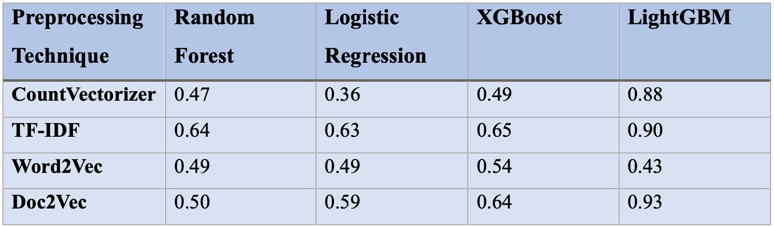
Accuracy Scores:

Slide 27
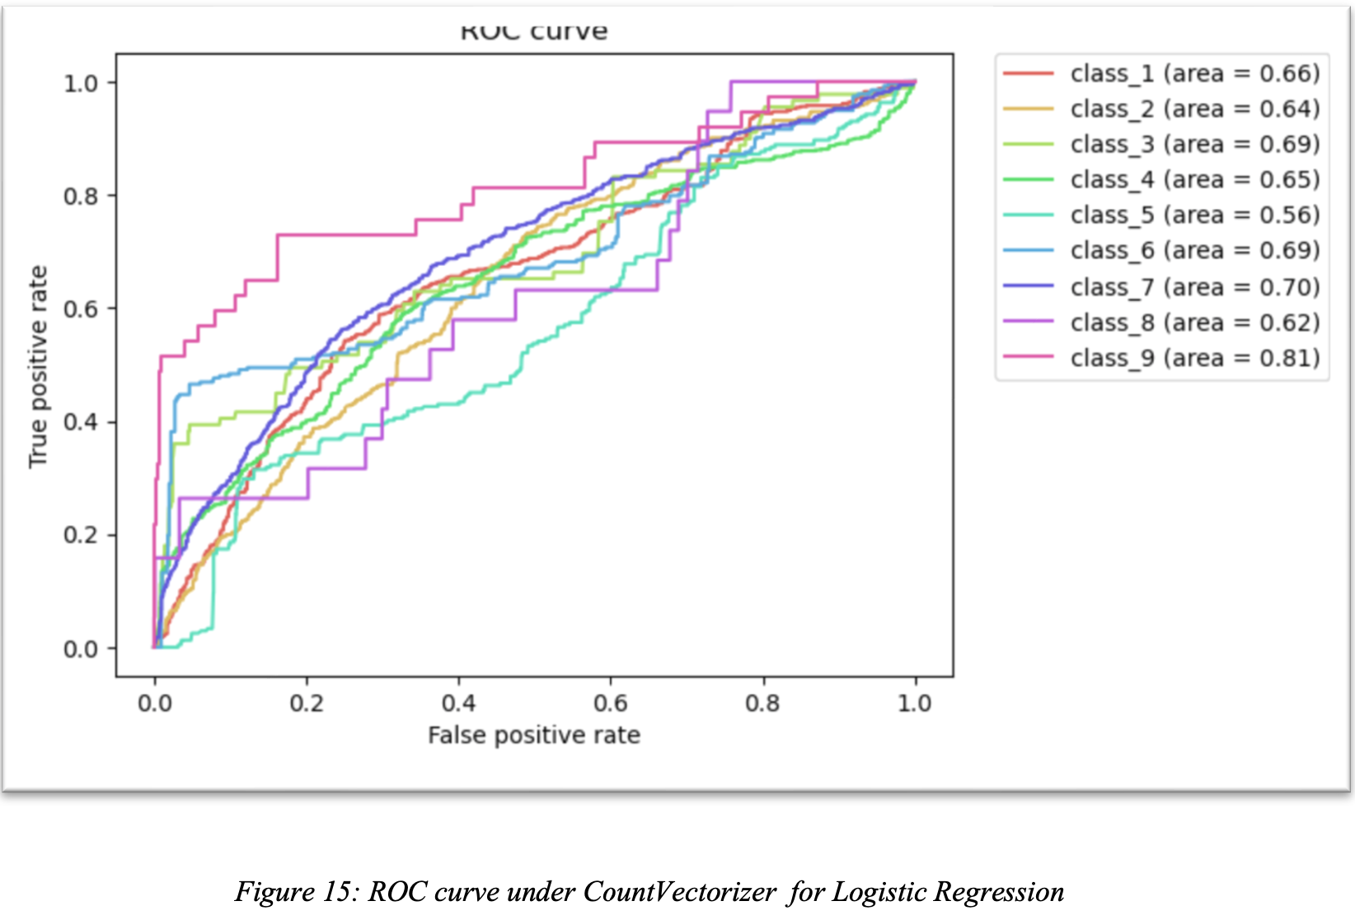
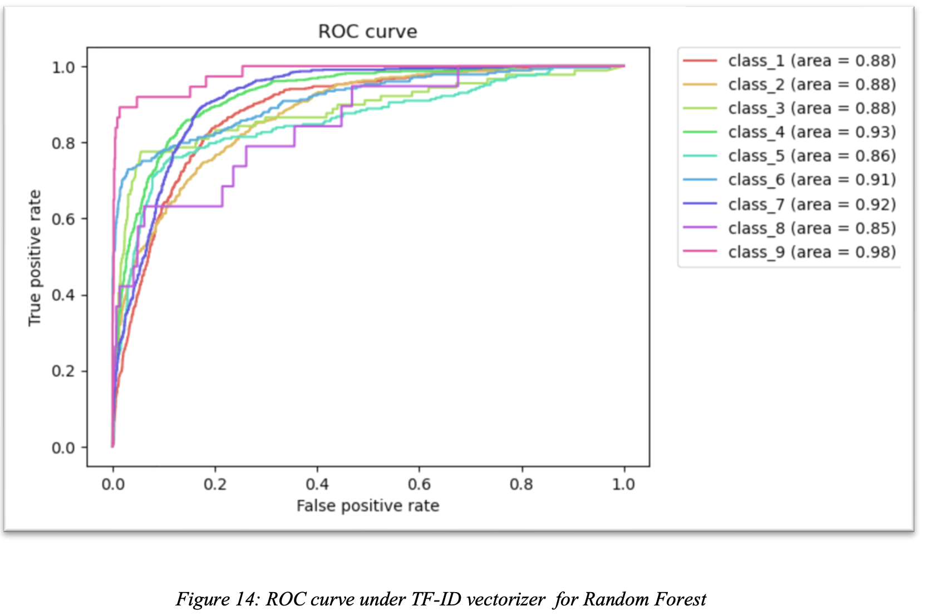
ROC curve:

Slide 28
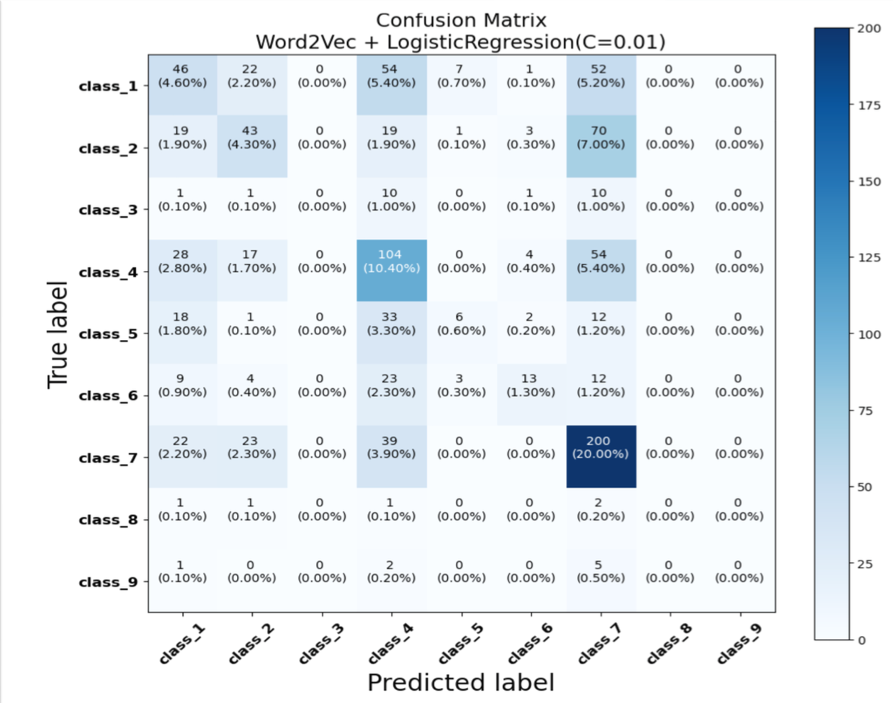
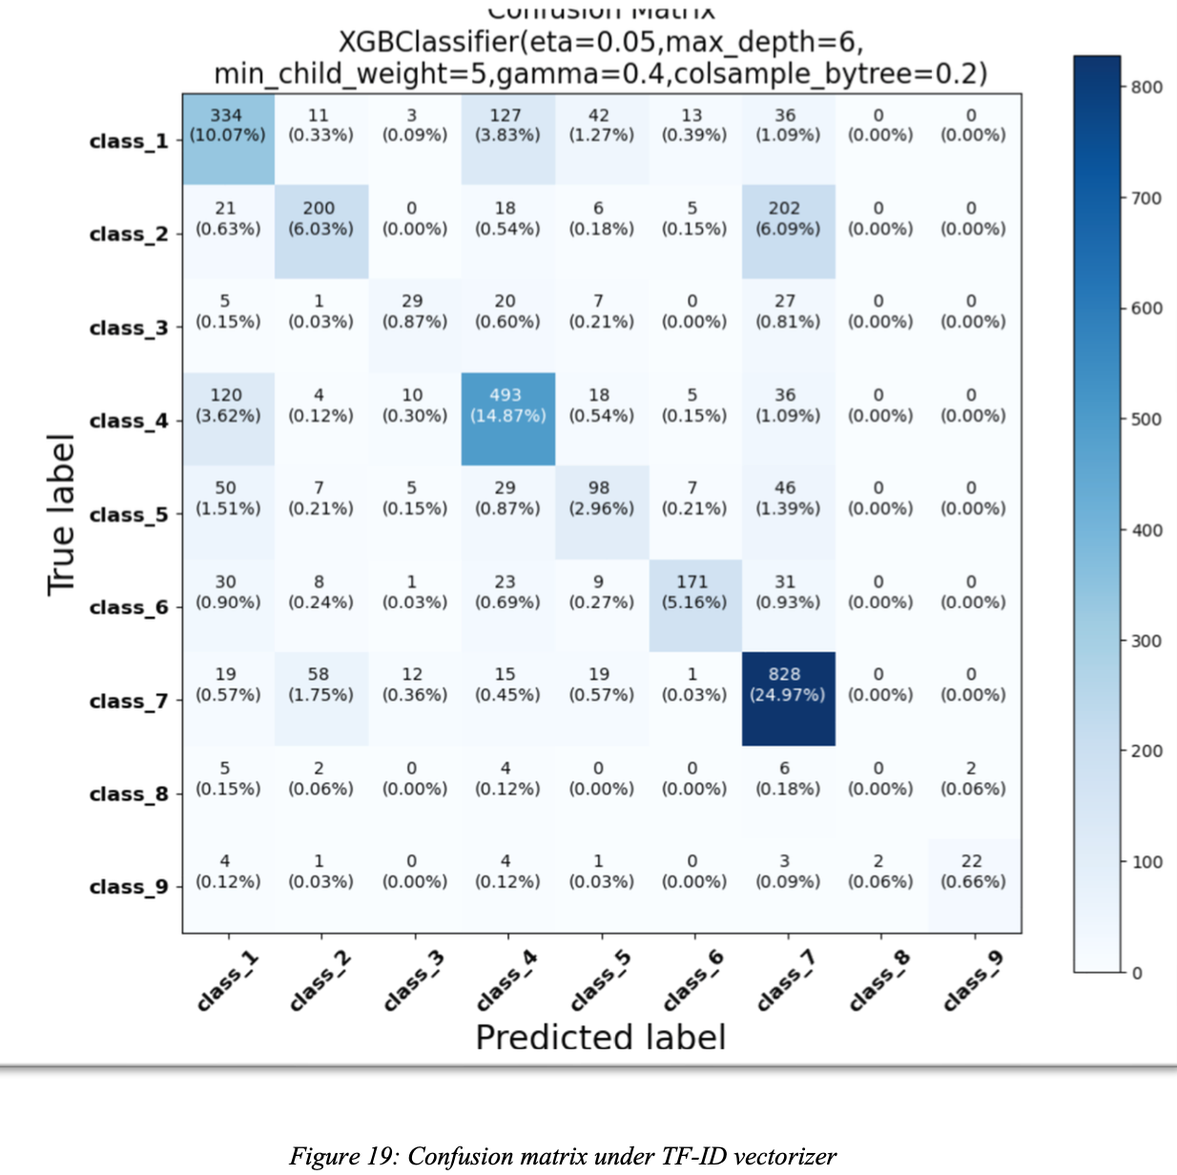
Confusion Matrix

Slide 29
Conclusion
Project Summary:
This project applied machine learning techniques to classify genetic mutations, utilizing clinical evidence and various vectorization techniques for text processing.
Key Findings:
Model Comparison: XGBoost and LightGBM emerged as the top-performing models, especially with TF-IDF and Doc2Vec, indicating their suitability for capturing complex patterns in genetic mutation data.
Feature Extractions Impact: Each vectorizer provided unique insights, with TF- IDF and Doc2Vec yielding the highest accuracy across models, validating their effectiveness in extracting relevant features.
Hyperparameter Tuning: GridSearchCV significantly optimized model performance by adjusting key parameters, allowing each model to reach its potential within our dataset.
Future Directions:
Explore deep learning approaches like CNN for further improvements in accuracy.
Implement advanced feature engineering techniques like biobert to capture additional patterns in clinical evidence.

Slide 30
Thankyou

